Slide 1
Substance and non substance addiction
Ms. Rabia Junaid
Lecturer (Psychology)
Science and Humanities

Slide 2
Learning Outcomes
The difference between Chemical and Non Chemical addiction
Impact of chemical/drug addiction on a person

Slide 3
Important terminologies
Drug
any substance /chemical that produces changes in our bodies or mind.
Addiction
a condition in which a person is unable to stop using a substance or engaging in a behavior.

Slide 4
Terminologies:
Intoxication is a state in which a person has consumed enough alcohol or drugs that their mood and physical and mental abilities are noticeably affected. For example, a person has reached the point of alcohol intoxication when the alcohol produces mental or physical impairments, such as slurred speech, difficulty walking, or disorientation.
Drug tolerance is defined as the diminished response to a drug, alcohol, or other substance over the course of repeated or prolonged exposure. It is a physiological response to a drug that requires greater quantities to offer the same response. When people develop tolerance, they need increasing doses of the substance to produce the effect.

Slide 5
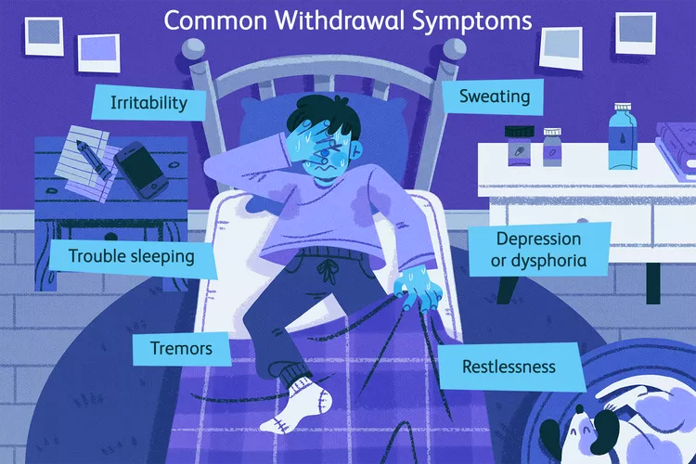
Terminologies:
Withdrawal is the combination of physical and mental effects a person experiences after they stop using or reduce their intake of a substance such as alcohol and prescription or recreational drugs.

Slide 6
What is addiction?
Addiction is a complex, chronic brain condition influenced by genes and the environment that is characterized by substance use or compulsive actions that continue despite harmful consequences.
A person with an addiction uses a substance, or engages in a behavior, for which the rewarding effects provide a compelling incentive to repeat the activity, despite detrimental consequences.
Addiction may involve the use of substances such as alcohol, inhalants, opioids, cocaine, and nicotine, or behaviors such as gambling.

Slide 7
Types of Addiction
Chemical Addiction
Refers to addiction that involves the use of substances. E.g., alcohol, marijuana etc.
Non Chemical Addiction
Refers to addiction that involves compulsive behaviors. Includes things such as gambling, risky sex, food, the internet, mobile devices, and shopping. These are sometimes called behavioral addictions.
When a person engages in these behaviors in excess and can’t stop, it becomes an addiction.

Slide 8
Substance/drug addiction

Slide 9
Repeated exposure leading to Addiction
Substance addiction (or drug addiction) is a neuropsychiatric disorder characterized by a recurring desire to continue taking the drug despite harmful consequences.
Addiction is caused by the actions of drug abuse and generally requires repeated drug exposure. This process is strongly influenced both by the genetic makeup of the person and by the psychological and social context in which drug use occurs.

Slide 10
Neurobiological changes (How the brain responds to drugs)
Dopamine is secreted by the brain during healthy activities, but drugs like cocaine or heroin (or compulsive behaviors, like gambling, shopping, or eating) will force the brain to release massive amounts of dopamine, and then prevent the brain from reabsorbing the dopamine, making the pleasurable experience last unnaturally longer.
In many cases of chronic or severe substance use, this actually changes the brain’s chemistry to the point where normal activities (e.g., one’s favorite food, sex, etc.) don’t produce the same amounts of dopamine that they used to.
In the context of associative learning, the brain has been reprogrammed to associate the blast of euphoria from drugs or compulsive behavior with only feelings of pleasure, reward, and the anticipation of more pleasure and reward. Healthy activities don’t register on the radar anymore, so they are discarded and eventually forgotten.

Slide 11
Neurobiological Changes
While early use of a drug may indeed be by choice, the neurobiological changes that occur with continued use, particularly to the prefrontal cortex among other regions related with executive function, compromise inhibitory control which when coupled with physiological and psychological craving for the drug lead to uncontrolled drug use
Thus, it is the mechanisms that occur as a result of taking the drug that make uncontrolled substance use a disorder.

Slide 12
Common symptoms of drug addiction
Needing more of the substance to get the effect you want (tolerance).
If you go too long without drugs, you experience symptoms such as nausea, restlessness, insomnia, depression, sweating, shaking, and anxiety.
Loss of control over your drug use. You often do drugs or use more than you planned, even though you told yourself you wouldn't. You may want to stop using, but you feel powerless.
Your life revolves around drug use. You spend a lot of time using and thinking about drugs, figuring out how to get them, or recovering from the drug's effects.

Slide 13
5. You've abandoned activities you used to enjoy, such as hobbies, sports, and socializing, because of your drug use.
6. You continue to use drugs, despite knowing it's hurting you. It's causing major problems in your life—blackouts, financial issues, infections, mood swings, depression, paranoia—but you use anyway.
7. Giving up important social, occupational, or recreational activities because of substance use

Slide 14
Drug Abuse Process
1
2
3
4
Trying the drug
Regular use
Dependence
Substance abuse disorder
Regular use lead to risky use

Slide 15
The Stages of Drug Addiction
Stage 1: Experimentation
Defined as the voluntary use of drugs without experiencing any negative social or legal consequences. For many, experimenting may occur once or several times as a way to “have fun” or even to help the individual cope with a problem. For many, experimentation can occur without any desire to continue using the drug.
Stage 2: Regular Use
Some people will be able to enter the stage of regular use without developing a dependence or addiction. These people will be able to stop the drug use on their own. The problem with regular use is that the risk for substance abuse greatly increases during this stage.

Slide 16
Stage 3: Risky Use/Abuse
This stage is defined as continued use of drugs in spite of severe social and legal consequences. This is the stage where the warning signs of addiction will begin to appear: craving, preoccupation with the drug, and symptoms of depression, irritability and fatigue if the drug is not used.
Stage 4: Drug Addiction and Dependency
Characteristics of dependence and drug addiction at this stage includes withdrawal symptoms and compulsive use of the drug despite severe negative consequences to their relationships, physical and mental health, personal finances, job security and criminal record.

Slide 17
Causes of addiction
1. Biological factors
Studies show that genetic factors are responsible for 40% to 60% of the vulnerability to any substance use disorder. If you have a first-degree relative (biological sibling or parent) with SUD, you’re more likely to develop it.
2. Psychological Factors
Personality factors: Both impulsivity and sensation seeking have been linked to substance use and gambling disorders.
Trauma and abuse: Early exposure to significant adverse experience can contribute to the development of substance use disorders.
Mental health factors: Conditions such as depression, anxiety, attention deficit disorder, and post-traumatic stress disorder (PTSD) increase the risk of addiction.

Slide 18
3. Environmental Factors
Family factors: Having a parent or sibling with an addictive disorder raises the risk, as does a lack of parental supervision or support. Poor-quality or troubled parent-child relations and family disruptions such as divorce also add to one's risk, as does sexual, physical, or emotional abuse.
Accessibility factors: Easy availability of alcohol or other substances in one’s home, at school or work, or in one’s community increases the risk of repeated use.
Peer group: As profoundly social animals, people are strongly influenced by their peers and, in generally seeking to be liked by them, may adopt many of their behaviors, particularly during adolescence.

Slide 19
Stimulants
Stimulants are group of substances that increase the activity of the central nervous system, resulting in increased blood pressure and heart rate, more alertness, and sped-up behavior and thinking.
What is their effect on the mind?
Produce a sense of pleasure, enhance self esteem, improve mental and physical performance, increase activity, reduce appetite, extend wakefulness.

Slide 20
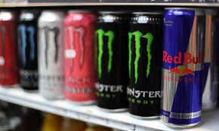
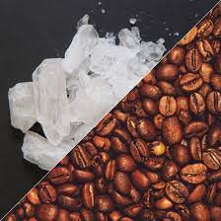
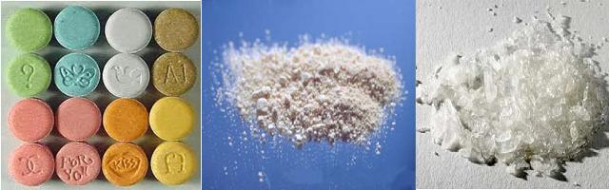
Stimulants (Uppers)
What do they do? Speed up the brain and central nervous system.
Examples: Caffeine (coffee, energy drinks, tea) Nicotine (cigarettes) Amphetamines (meth, ecstasy) “Bath salts” Cocaine and Crack

Slide 21
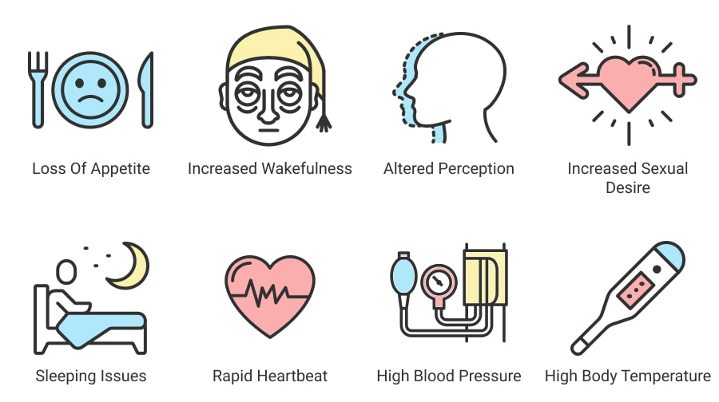
Side Effects of Stimulants
Meth Mouth” — rapid decay of a person’s teeth
Weight loss
Drug related psychosis
Organ failure
Death due to stroke, cardiac arrest

Slide 22
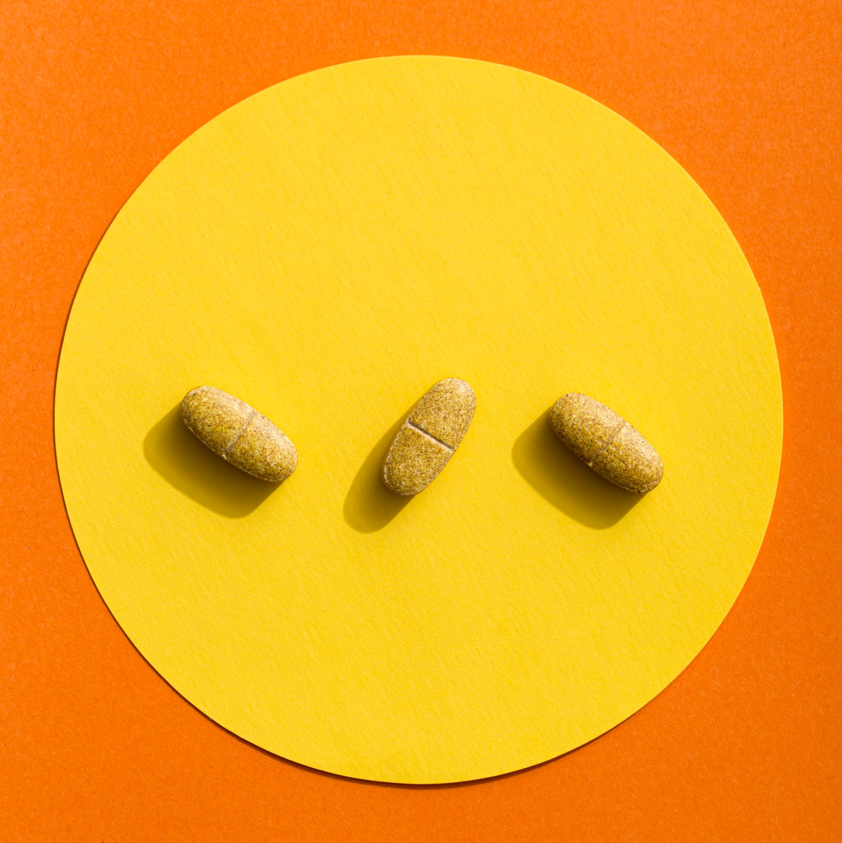
Depressants
Depressants slow the activity of the central nervous system. They reduce tension and inhibitions and may interfere with a person’s judgment, motor activity, and concentration.
The three most widely used groups of depressants are alcohol, sedative hypnotic drugs, and opioids.

Slide 23
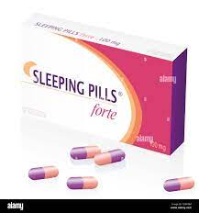
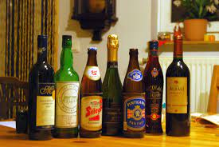
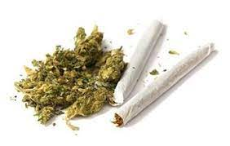
Depressants (Downers)
What do they do? Slow down the brain and central nervous system.
Examples: Alcohol (beer, wine, vodka, tequila, etc.) Heroin Tranquilizers Sleeping Pills Marijuana

Slide 24
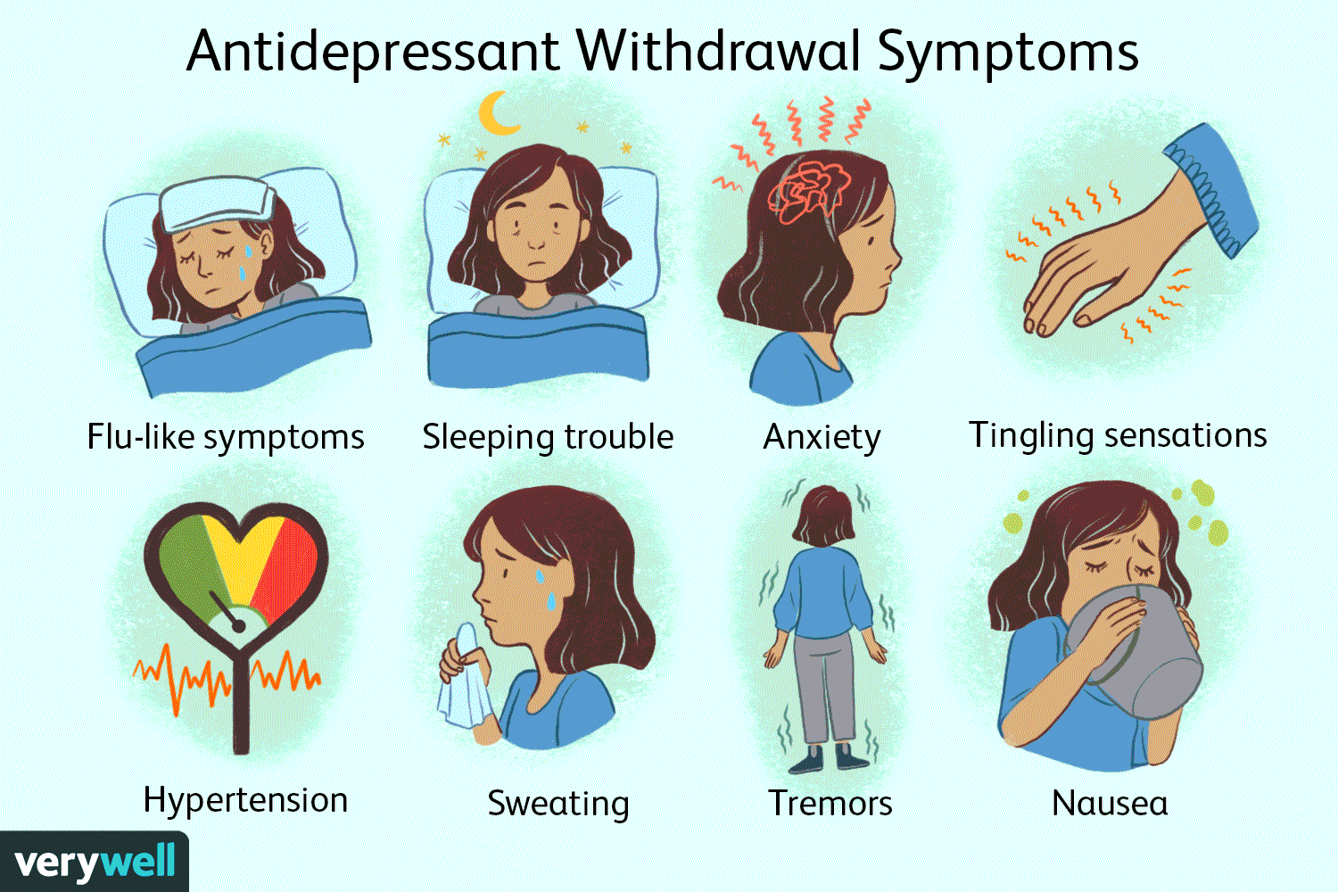
Side Effects of Depressants
COMA
Respiratory issues
Lung cancer
Death

Slide 25
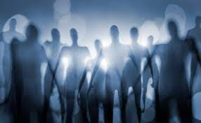
Hallucinogens
Hallucinogens are a group of drugs that can alter perception, thoughts, and feelings. Hallucinogens can be taken in a variety of ways: ingested, smoked and inhaled.
These produce powerful changes in sensory perception from strengthening a person’s normal perceptions to inducing illusions and hallucinations
They produce sensations so out of the ordinary that they are sometimes called “trips.”
The trips may be exciting or frightening, depending on how a person’s mind interacts with the drugs. Also called psychedelic drugs
https://www.youtube.com/watch?v=UTa_1DyrYk0

Slide 26
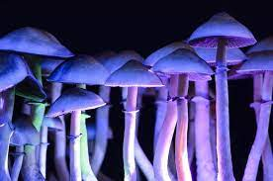
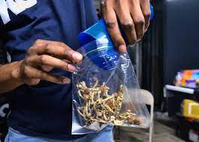
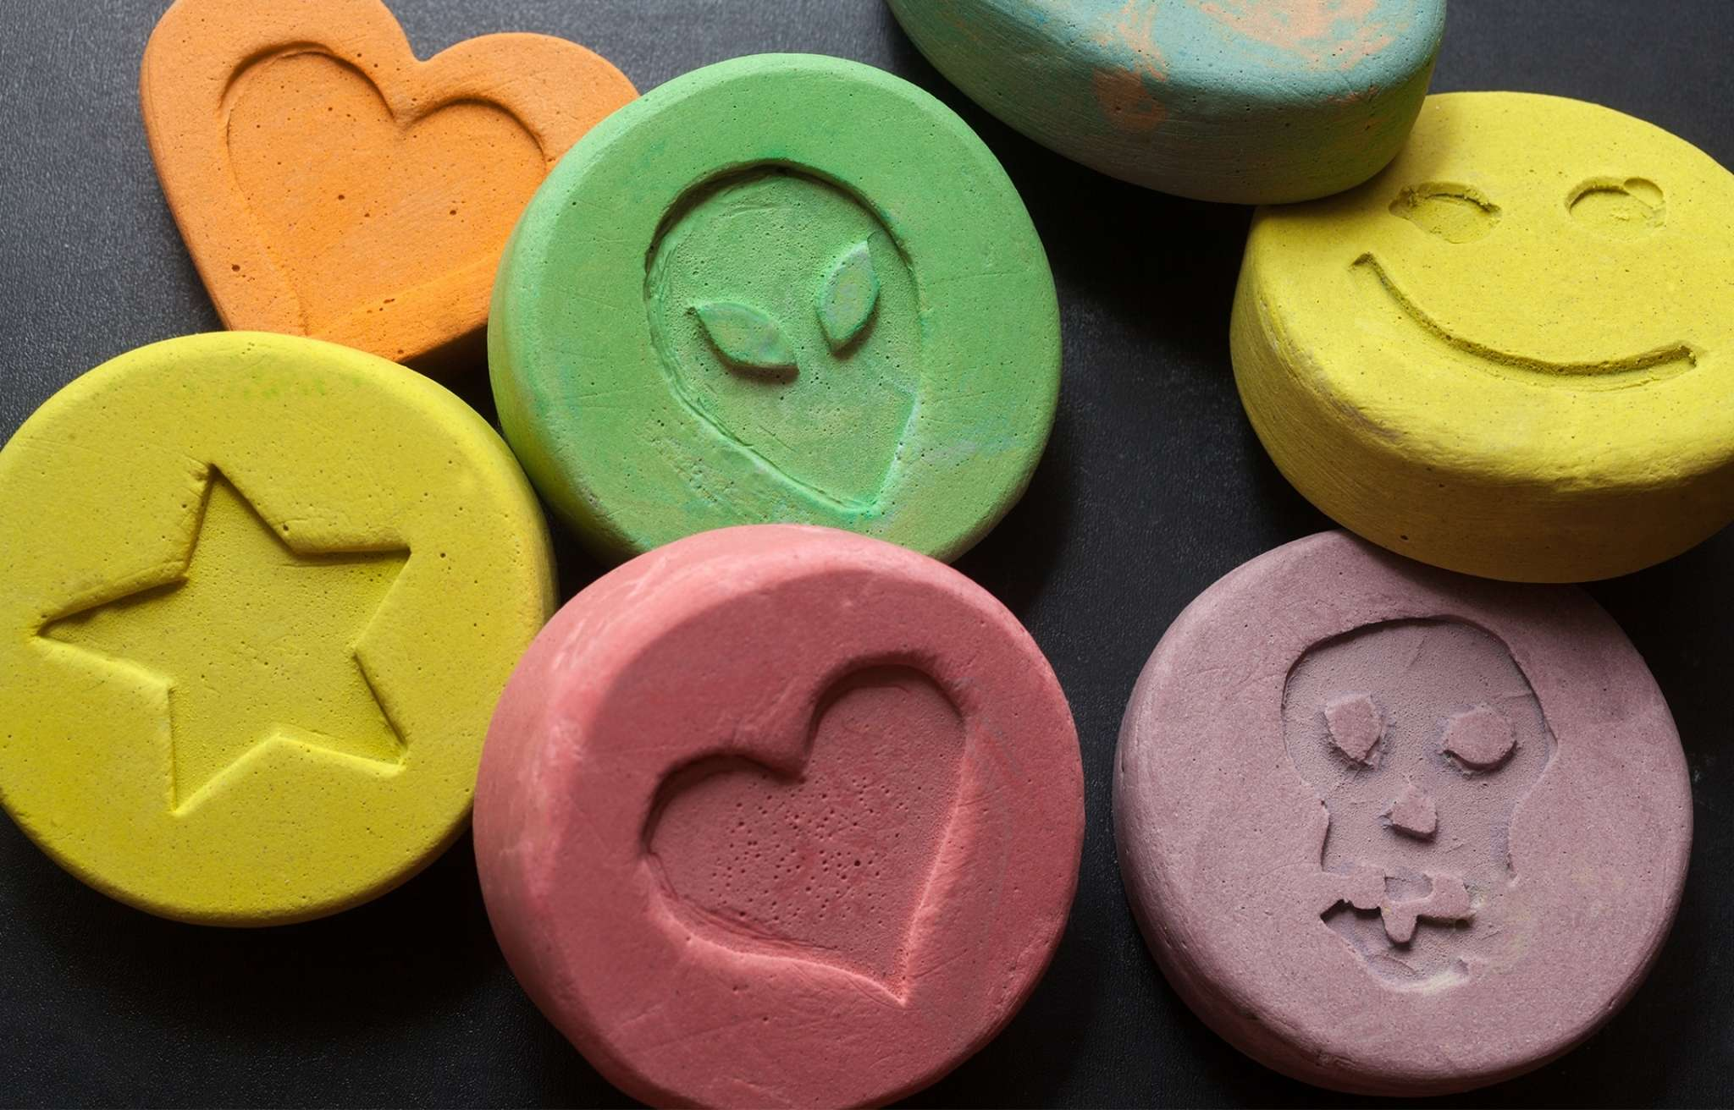
Hallucinogens
What do they do? These drugs alter the user’s state of consciousness. (Distort auditory and visual sensations)
Examples: LSD Ecstasy Magic mushrooms Cannabis

Slide 27
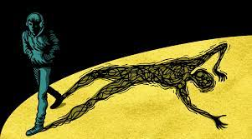
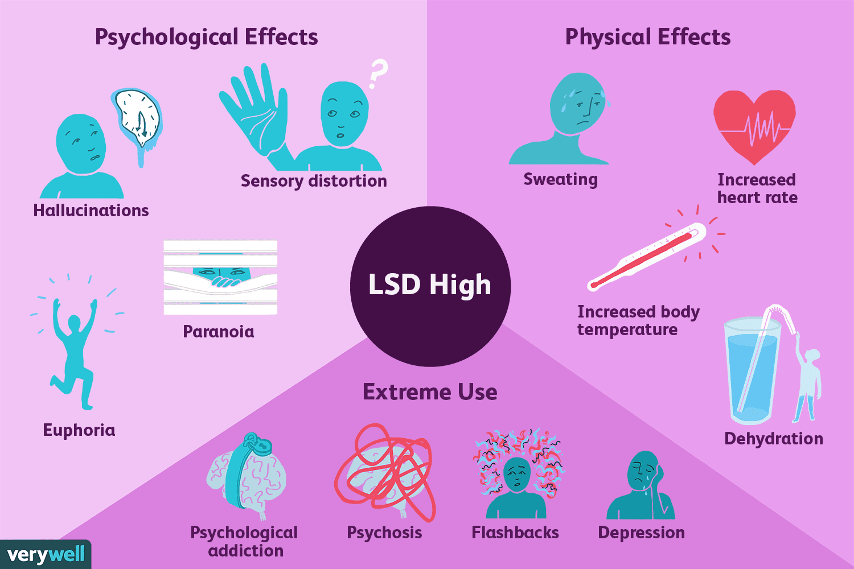
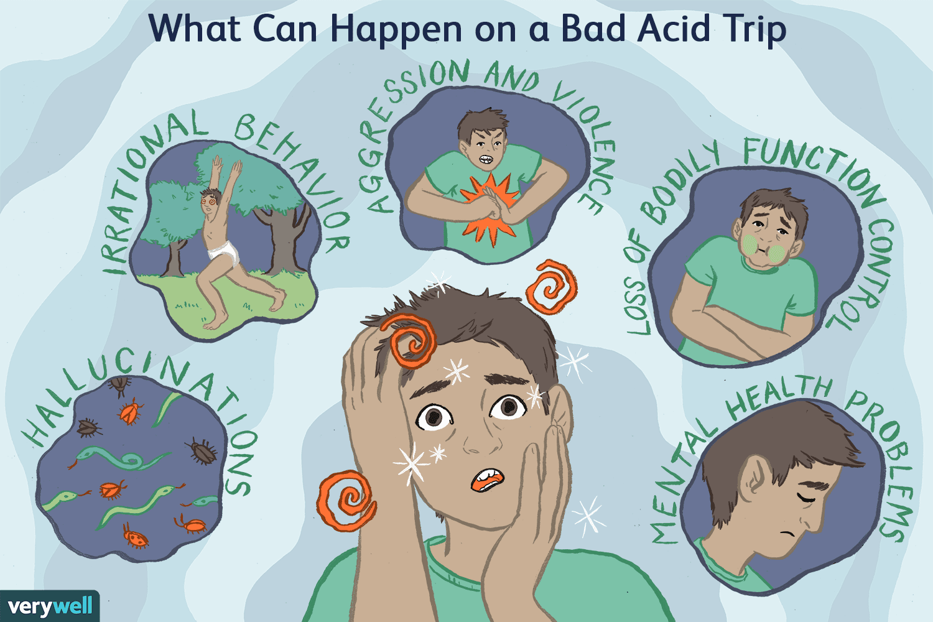

Slide 28
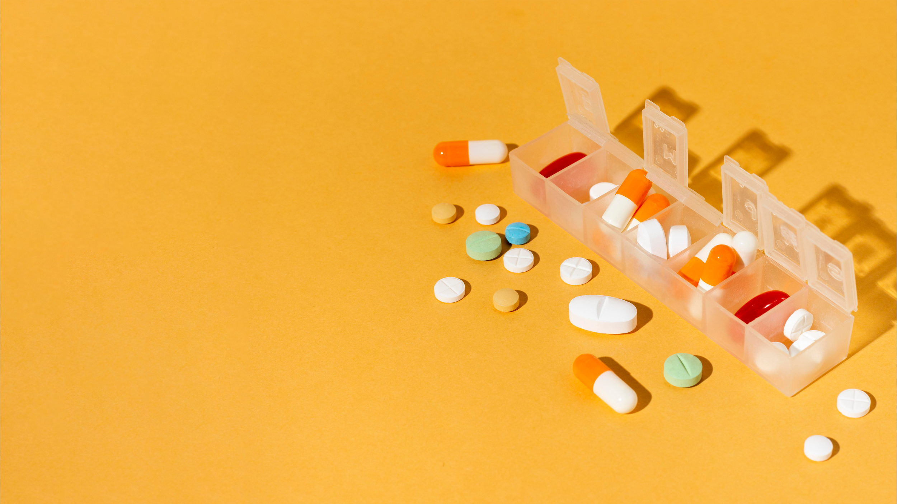
Theory

Slide 29
Why people who regularly take substances have tolerance and withdrawal reactions?

Slide 30
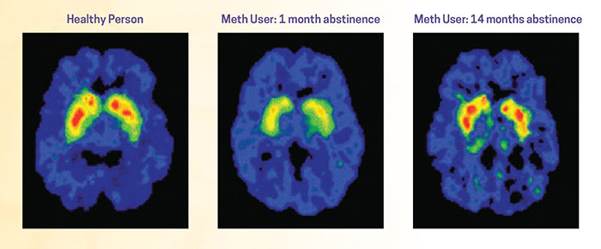
Drug Abuse is preventable & Drug Addiction is a treatable disease
Brains from addicts are different from the brains of people who are not addicted. It is difficult, in some cases impossible, to return the brain to normal. Because drug abuse and addiction have so many dimensions and disrupt so many aspects of an individual's life, treatment is not simple.

Slide 31
Effective treatment programs typically incorporate many components, each directed to a particular aspect of the illness and its consequences.
Addiction treatment must help the individual stop using drugs, maintain a drug-free lifestyle, and achieve productive functioning in the family, at work, and in society. Because addiction is typically a chronic disease, people cannot simply stop using drugs for a few days and be cured.
Most patients require long-term or repeated episodes of care to achieve the ultimate goal of sustained abstinence and recovery of their lives.

Slide 32
Consequences of Drug Use- Society
Crimes such as:
Drug possession
Drug use
Drug trafficking
Drug manufacturing
Theft
Break and enter
Robbery
Motor vehicle theft
Murder
RESULTS IN:
Jail Time
Massive Legal Fines
Becoming Employed
Homelessness
Failed Relationships With Family And Friends
Addiction/Dependency On Drugs Leading To More Crime
Death

Slide 33
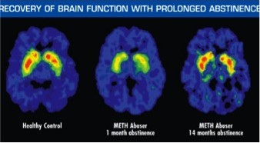
Drug Abuse is preventable and treatable disease
Brains from addicts are different from the brains of people who are not addicted. It is difficult, in some cases impossible, to return the brain to normal. Because drug abuse and addiction have so many dimensions and disrupt so many aspects of an individual's life, treatment is not simple. Effective treatment programs typically incorporate many components, each directed to a particular aspect of the illness and its consequences.
Addiction treatment must help the individual stop using drugs, maintain a drug-free lifestyle, and achieve productive functioning in the family, at work, and in society. Because addiction is typically a chronic disease, people cannot simply stop using drugs for a few days and be cured. Most patients require long-term or repeated episodes of care to achieve the ultimate goal of sustained abstinence and recovery of their lives.

Slide 34
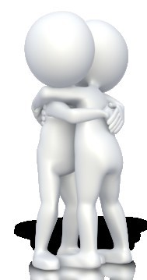
Drug abuse and addiction affect every segment of society. That’s all of us.
Not one person is immune from the disease of addiction.
Prevent drug abuse by :
Being informed of the risks associated with substance abuse
Involvement in alternative activities
Build self-confidence
Make positive future plans
Be brave enough to say “NO!”
Surround yourself with friends who disapprove of drug use
Solve underlying issues that might lead to future
drug abuse with a professional such as a school counselor.

Slide 35
Non-substance Addiction

Slide 36
Non-substance Addiction?
A non-substance addiction includes things such as gambling, risky sex, food, the internet and shopping. These are sometimes called behavioral addictions.
When a person engages in these behaviors in excess and can’t stop, it becomes an addiction.
Non-substance addictions can result in physical, emotional, and financial harm.

Slide 37
Examples of Non Substance Addiction
Plastic Surgery
Food
Gaming
Plastic Surgery
Sex
Social Media
Gambling
Internet
Risks
Shopping
Pornography

Slide 38
Symptoms of Non-substance Addiction
A person with a non-substance addiction is unable to stop doing the troublesome activity or behavior. For example, a person addicted to gambling may spend all his or her savings. A person addicted to sex may continue to have reckless sex and acquire a sexually transmitted disease (STD). Non-substance addiction symptoms can include:
Compulsive, excessive, and repetitive engagement in a risky behavior or activity.
Being unable to stop the activity.
Impaired judgment.
Being unable to control the behavior.
Craving the activity or behavior.
Being unable to recognize the consequences of the behavior (safety, financial, emotional, physical, death).
Strained work and personal relationships.
Inappropriate emotional response.

Slide 39
What causes a non-substance addiction?
Studies have shown that gambling activates similar parts of the brain as other drugs, like alcohol. These parts of the brain are responsible for our “reward” functions. This is what gives our bodies’ dopamine after we do some healthy behavior, like exercise or eating a good meal.

Slide 40
How are non-substance addictions diagnosed?
Some people with a non-substance addiction recognize the problem and seek help. Some people are told by family and friends. A mental health professional can diagnose the addiction.
Notes:
https://familydoctor.org/condition/non-substance-addiction/

